Slide 1
SOFTWARE DEVELOPMENT 3
File I/O in Java(1)

Slide 2
I/O Devices
Every hardware device that is connected to your
computer can be considered an I/O device
Physical Devices
  Input devices are mice, keyboards, scanners, CD-ROMs, joysticks, hard disks, memory sticks etc.
  Output devices are monitors, printers, speakers, CD-RW's, hard disks, memory sticks etc.
Logical Devices
  In addition to these physical devices, there are also logical devices that you can interact with from a Java program. For example, it is possible to treat memory as an I/O device.

Slide 3
File Input
Java classes that support file input are found in the java.io package
FileReader allows us to open a file for reading
BufferedReader is a class that reads text from a character-input stream, buffering characters so as to provide for the efficient reading of characters:
  increases the efficiency of reading
  The buffer size may be specified, or the default size may be used (8192 characters)

Slide 4
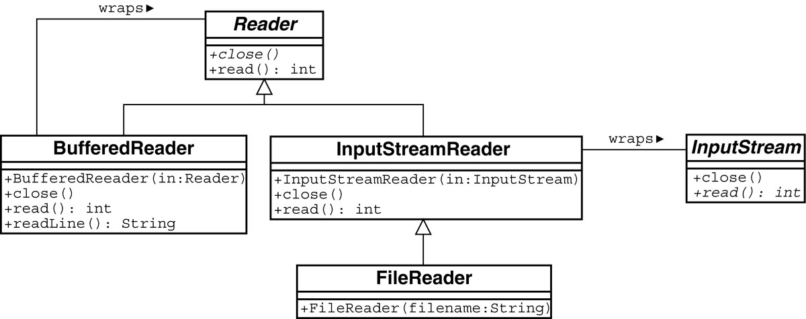
File Input

Slide 5
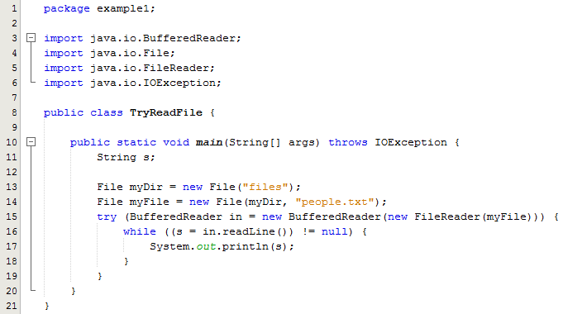
TryReadFile.java
Lines 13, 14: Overloaded Constructors in the File class
Line 13: When we create a FileReader object in Java, one of the things we're doing is asking it to open a file. If it can't, the FileReader constructor lets you know by throwing an exception instead of creating and returning a FileReader object. This is the reason that we include the throws IOException in line 10

Slide 6
Try with Resources
The try-with-resources statement at line 15 is a try statement that declares one or more resources.
A resource is an object that must be closed after the program is finished with it.
The try-with-resources statement ensures that each resource i.e the file is closed at the end of the statement
We will cover this in more detail as part of Exception Handling

Slide 7
Wrapper Classes
Class BufferedReader is said to wrap class FileReader if:
  FileReader is a concrete (not abstract) class
  BufferedReader’s constructor takes FileReader as an argument and stores a local copy of fileReader
  BufferedReader reimplements all of FileReaders’s methods

Slide 8
Buffered Input
We can make a file available for reading one character at a time by using
  FileReader fr = FileReader(filename);
We can read the file more efficiently by reading a block of characters at a time, this is called buffering the read
To perform a buffered read we use this
  BufferedReader br =
  new BufferedReader(
  new FileReader(filename));

Slide 9
Files
For storing information in a file we need an instance of the File class
  Abstract representation of file or directory pathnames
See TryReadFile.java
With this we can perform the following tasks:
  Determine if the file exists
  Obtain information about the file
  Create a file
  Open a file
  Read data from a file
  Write data to a file
  Close a file

Slide 10
File Class
Methods of the File class:
  boolean canRead() –true/false if readable
  boolean canWrite() – true/false if you can write to it
  boolean delete() – deletes the file, return indicates success/not
  boolean exists() – true if file already exists
  boolean isDirectory() – true if folder, false otherwise
  boolean isFile() – true if ordinary file, false if folder
  long lastModified() – returns system specific time when file last modified
  String[] list() – if folder returns a list of the names of the files that exist in folder
  File[] list() – if folder returns an array of (File objects of) the files that exist in folder
  boolean mkdir() – creates a folder with the name of this file, return true/false depending on success

Slide 11
Creating a File
Create a file object using a constructor that
  Takes the name of the file as a String and the pathname as a String
    File x = new File(“files”, “data.txt”);
  Takes the name of the file as a String and its directory as a file
    File myDir = new File(“files");
    File myFile = new File(myDir, "people.txt");
In the above example the file appears in its directory as “people.txt”
In the Java program it is referred to as myFile

Slide 12
Reading From a Text File Using Scanner
The class Scanner can be used for reading from the keyboard as well as reading from a text file
  Simply replace the argument System.in (to the Scanner constructor) with a suitable stream that is connected to the text file
  Scanner StreamObject =
  new Scanner(FileName);
Methods of the Scanner class for reading input behave the same whether reading from the keyboard or reading from a text file
  For example, the nextInt and nextLine methods

Slide 13
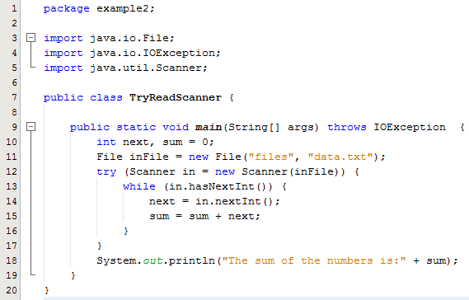
Reading From a Text File Using Scanner
Line 13: The hasNextInt method can be used to check that the next token to be input is a suitable element of the appropriate type i.e. integer in this case
Note also the use of try with resources here

Slide 14
Testing for the End of a Text File with Scanner
A program that tries to read beyond the end of a file using methods of the Scanner class will cause an exception to be thrown
However, instead of having to rely on an exception to signal the end of a file, the Scanner class provides methods such as hasNextInt and hasNextLine
    These methods can also be used to check that the next token to be input is a suitable element of the appropriate type

Slide 15
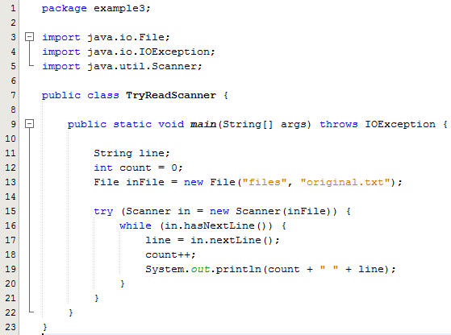
Testing for the End of a Text File with hasNextLine
The hasNextLine method can be used to check that the next token to be input is a suitable element of the appropriate type i.e. String in this case

Slide 16
Reading Numbers
Unlike the Scanner class, the class BufferedReader has no methods to read a number from a text file
  Instead, a number must be read in as a string, and then converted to a value of the appropriate numeric type using one of the wrapper classes
  To read in a single number on a line by itself, first use the method readLine, and then use Integer.parseInt, Double.parseDouble, etc. to convert the string into a number
  If there are multiple numbers on a line, StringTokenizer can be used to decompose the string into tokens, and then the tokens can be converted as described above

